Slide 1
Leveraging WordNet for Word2Vec Model
Ameet Deshpande and Monisha Jegadeesan. 2019. Leveraging Ontological Knowledge for Neural Language Models. In Proceedings of the ACM India Joint International Conference on Data Science and Management of Data (CoDS-COMAD '19). ACM, New York, NY, USA, 350-353. DOI: https://doi.org/10.1145/3297001.3297059

Slide 2
Word2Vec
Notes:
NLP tasks such as sentiment analysis, question answering, and dialogue generation
Word2Vec – words from the vocabulary are mapped to vectors of real numbers
Encoding semantic relatedness between words

Slide 3
Challenges with Neural Language Models
Data-hungry (the best performing vectors were trained on 100 billion words)
Achieving higher accuracy takes a lot of training time
Domain corpus is relatively small
The target domain’s corpus may not represent relationships with more general words and may thus lack “common sense" knowledge
Domain Transfer: Domain Transfer involves using word-embeddings learned on a di erent domain or dataset and adapting it to the one at hand

Slide 4
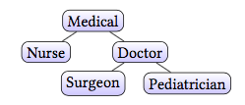
Ontological Knowledge Bases
GICS, country-currency

Slide 5
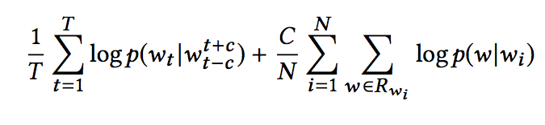
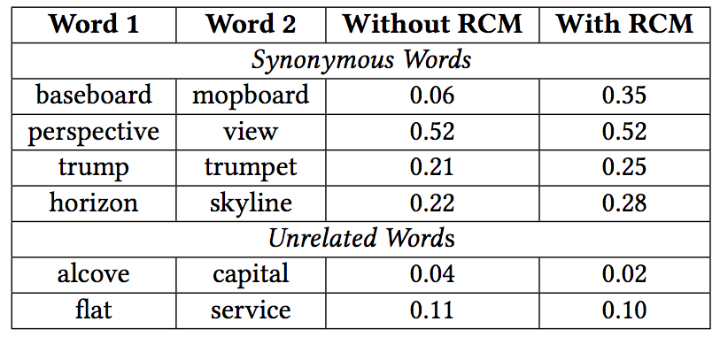
Leveraging WordNet in Word2Vec

Slide 6
Other Ideas
sim(nurse, doctor) < sim(pediatrician, surgeon)
sim(medical, doctor) < sim(doctor, surgeon), and sim(medical, doctor) < sim(doctor, pediatrician)

